Slide 1
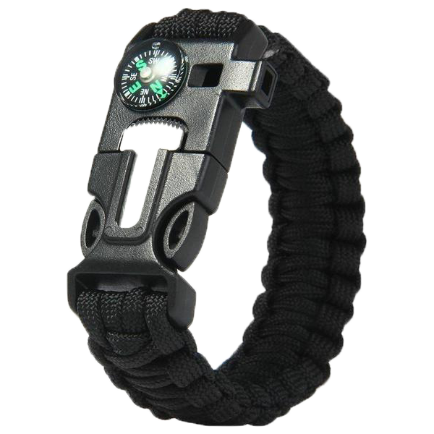
Survival Wristband
Group 1
Teamwork 1

Slide 2
Group Member
B10423002 Leon
B10423003 Kurumi
B10423009 Jerry
B10423015 Justin
B10423032 Kevin
B10423041 Dan
B10423045 Rong
A10423050 Ian
W10523301 Ben

Slide 3
Introduction

Slide 4
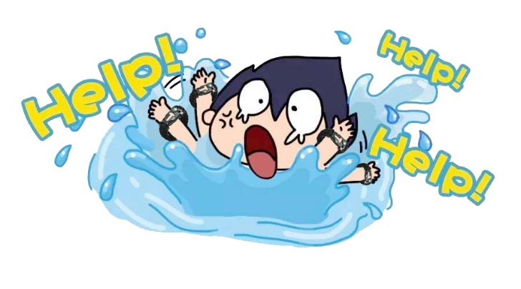
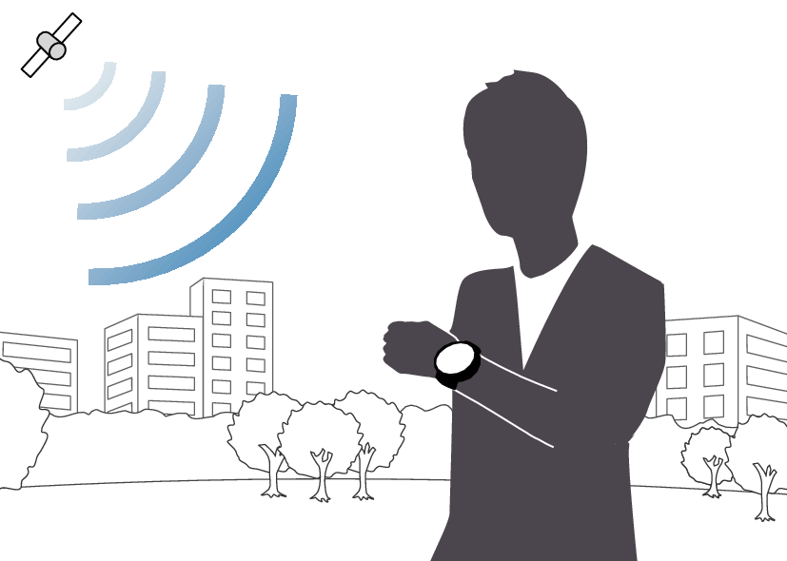
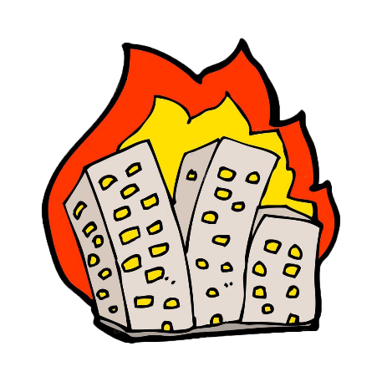
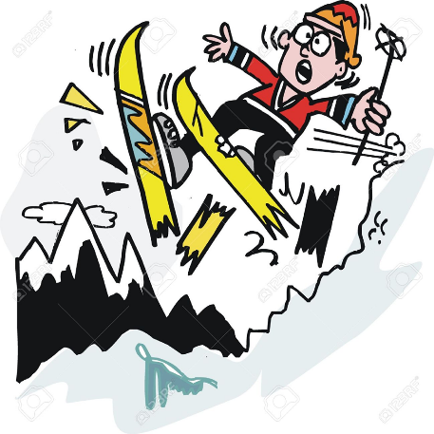
Introduction
This is our survival wristband system. When the people encounter emergency situation such as drowning, fire, mountain rescue, it will provide notification and location for rescue team. Furthermore, it will provide current time , physical status, medical history and other life aspect function.

Slide 5
Use Case Diagram

Slide 6
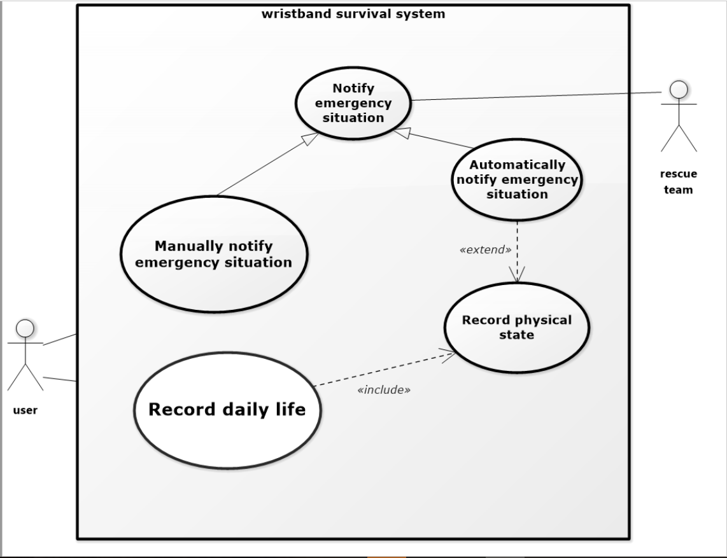
Use Case Diagram
Use Case Diagram

Slide 7
Use Case Description

Slide 8
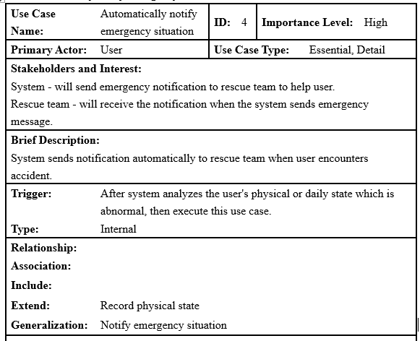
Use Case Description

Slide 9
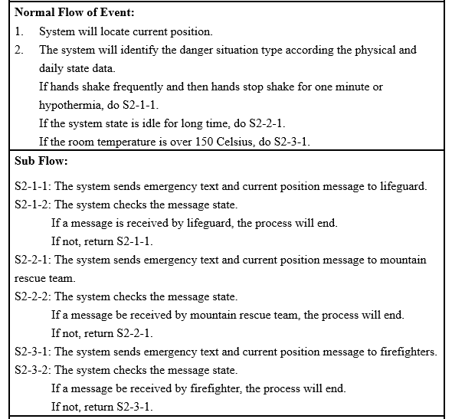
Wristband

Slide 10
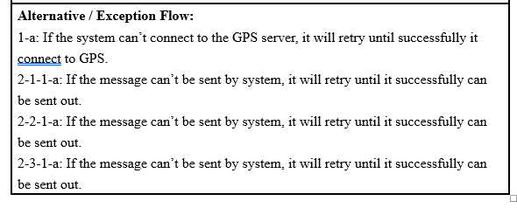
Wristband

Slide 11
Activity Diagram

Slide 12
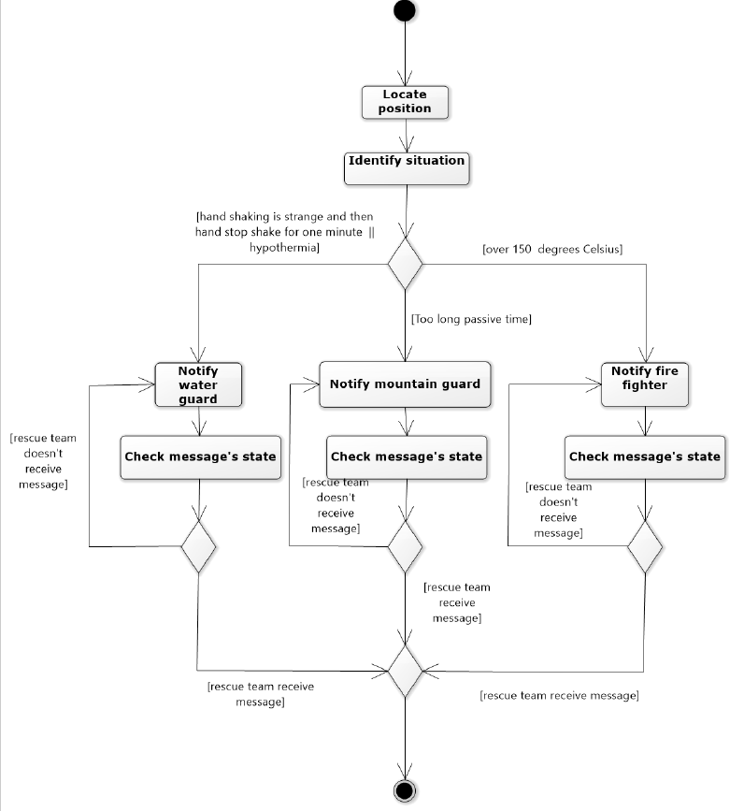
Activity Diagram

Slide 13
Sequence Diagram

Slide 14
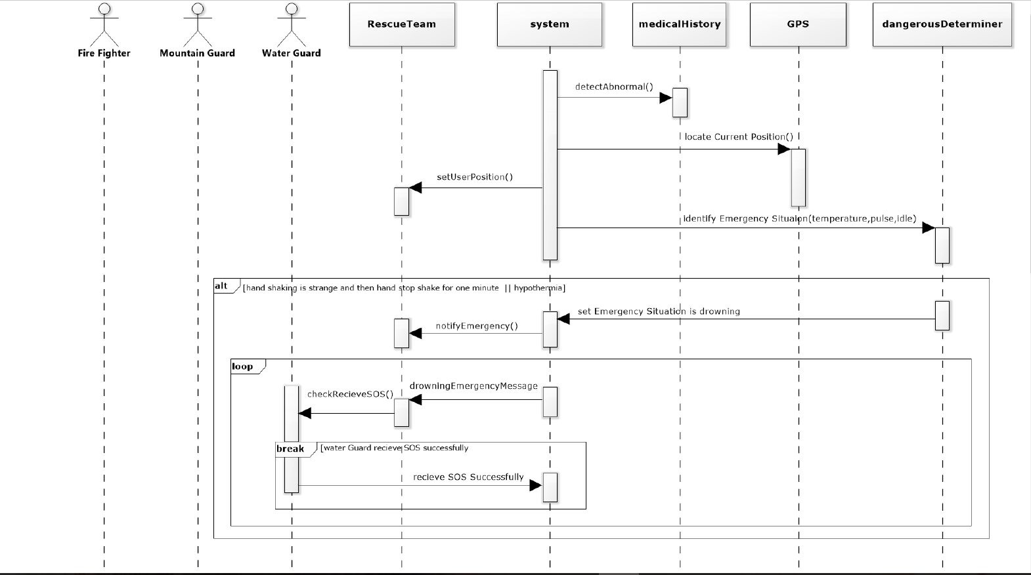
Sequence Diagram

Slide 15
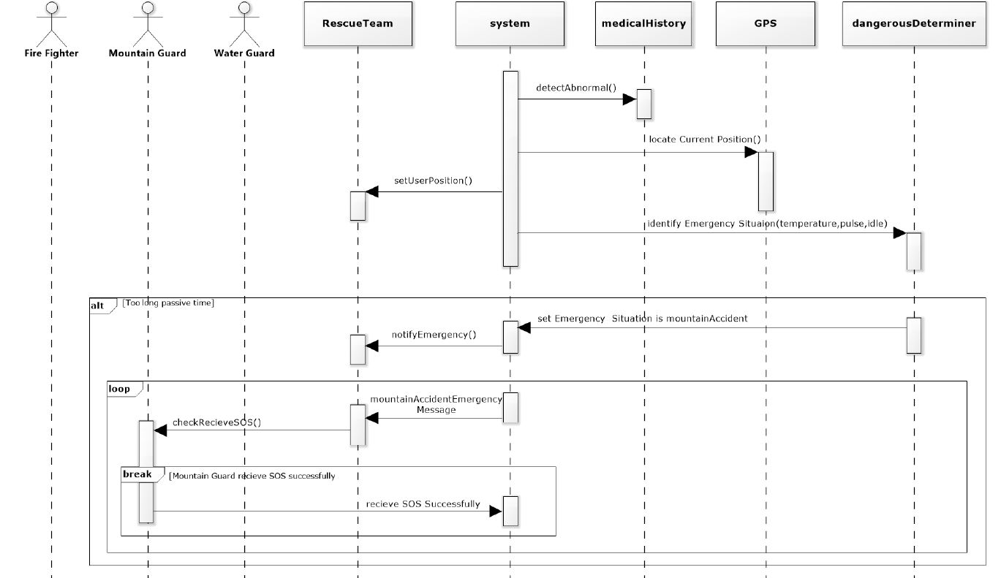
Wristband

Slide 16
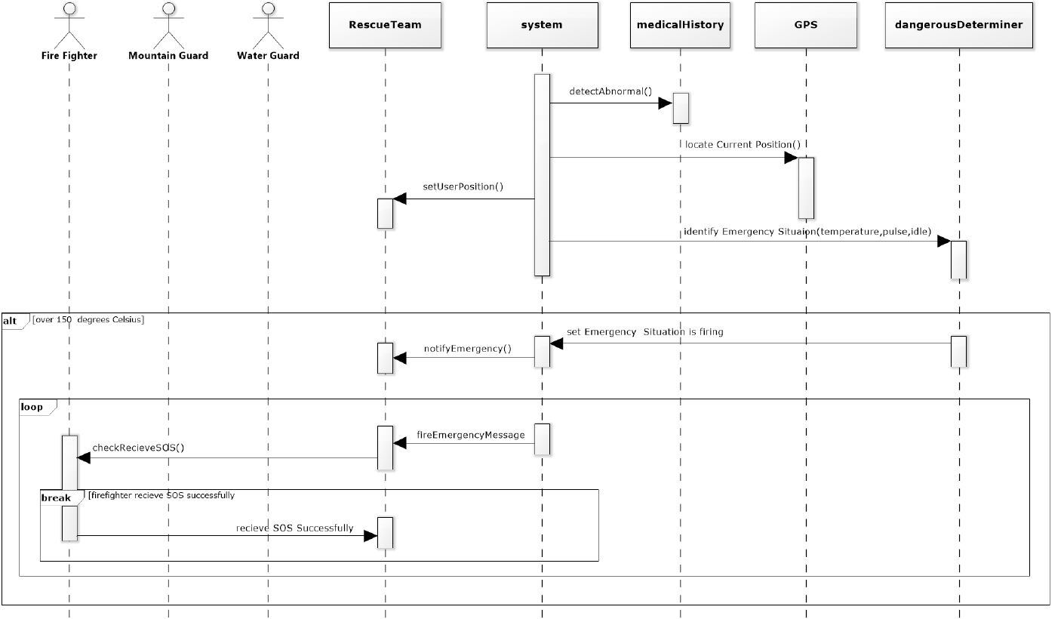
Wristband

Slide 17
Class Diagram

Slide 18
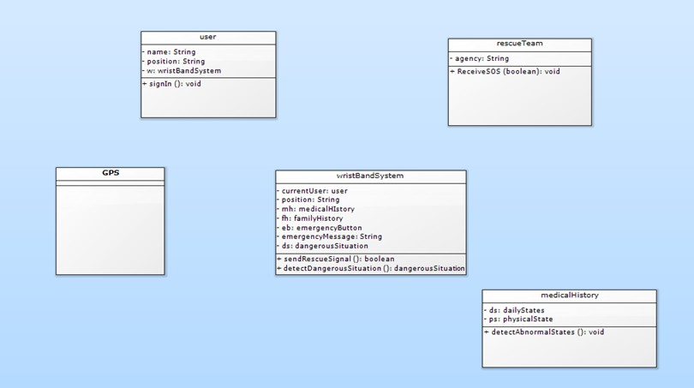
Class Diagram

Slide 19
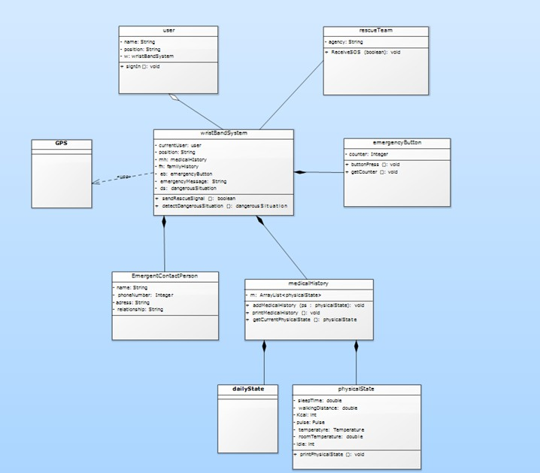
Class Diagram(cont.)

Slide 20
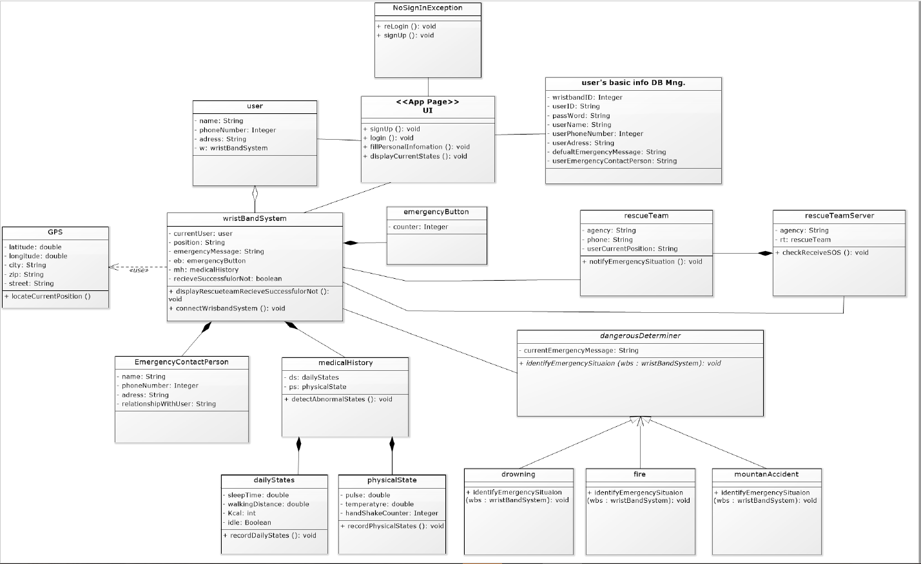
Class Diagram(cont.)

Slide 21
Behavior State Machine

Slide 22
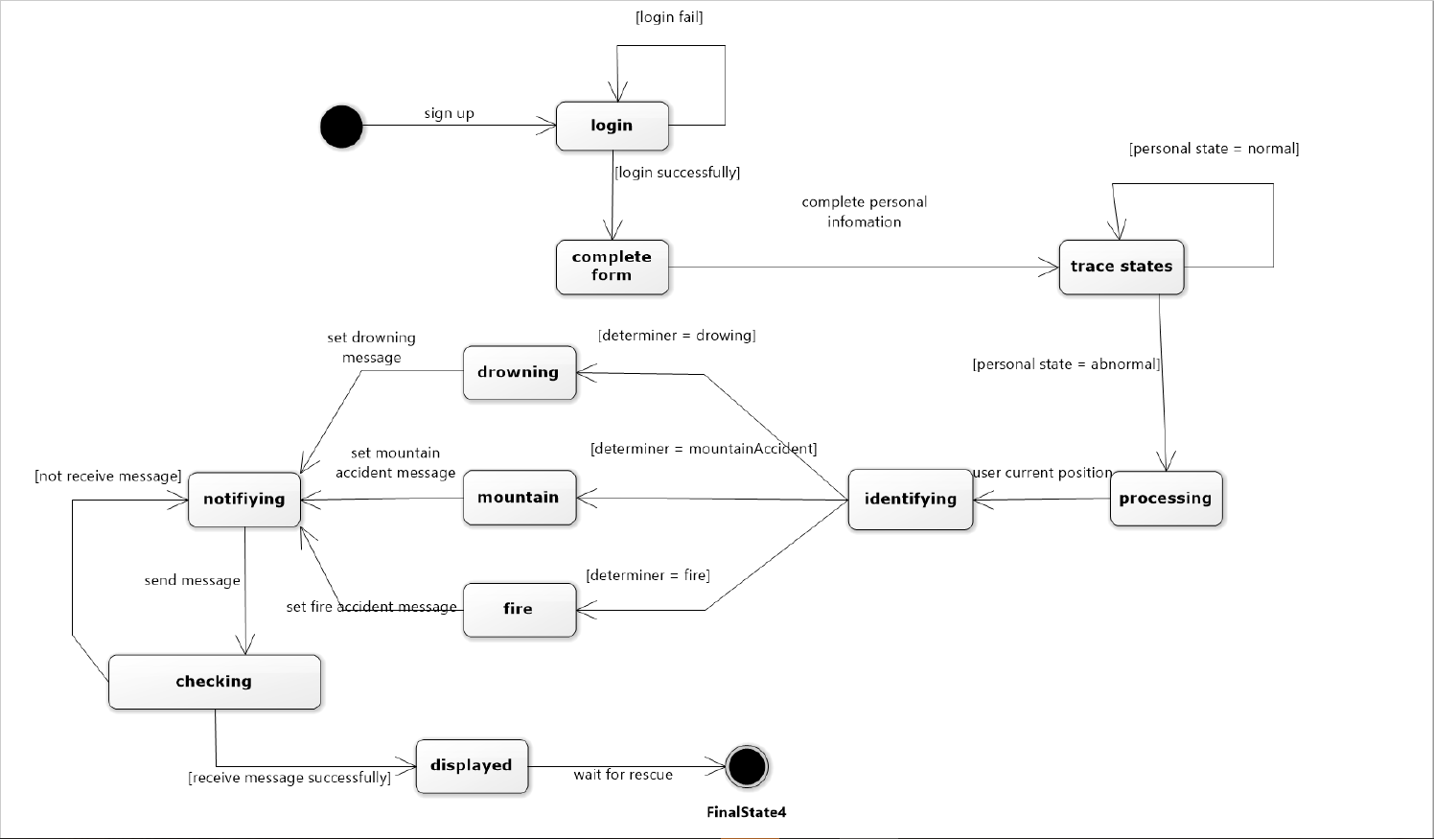
Behavior State Machine
Wristband

Slide 23
Thank you!

